Slide 1
Chapter 16
Database Administration and Security

Slide 2
Learning Objectives
After completing this chapter, you will be able to:
Describe the impact of data quality on a company’s assets and competitive position
Describe the role of the database in supporting operational, tactical, and strategic decision-making
Describe the impact that the introduction of a DBMS has on technological, managerial, and cultural aspects of an organization
Describe the managerial and technical roles of the database administrator
Describe the processes and systems in the information security framework that support the three database security goals
Identify the standards, strategies, and tools used in database administration
Describe the impact that cloud-based data services have on the role of the DBA
Perform various technical tasks of database administration with Oracle

Slide 3
Data as a Corporate Asset (1 of 3)
Data is a valuable resource that can translate into information
If the information is accurate and timely, it can enhance the company’s competitive position and generate wealth
An organization is subject to a data-information-decision cycle
Data user applies intelligence to data to produce information that is the basis of knowledge used in decision making

Slide 4
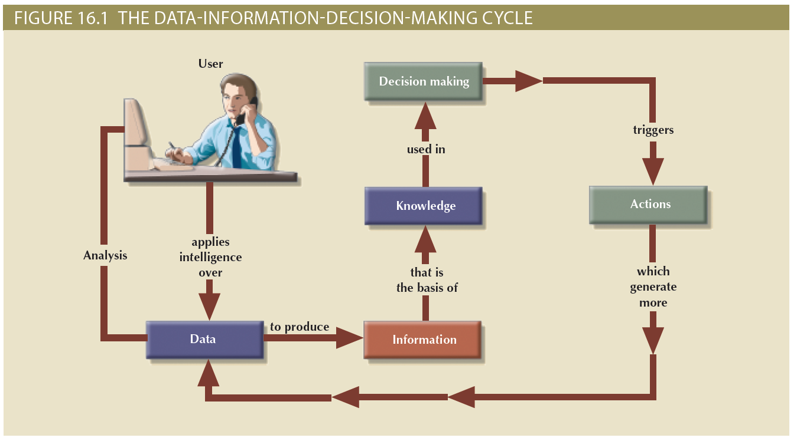
Data as a Corporate Asset (2 of 3)

Slide 5
Data as a Corporate Asset (3 of 3)
Dirty data
Suffers from inaccuracies and inconsistencies
Data quality
Ensures accuracy, validity, and timeliness of data
Data profiling software
Determines data patterns and compares them against standards defined by the organization
Master data management (MDM) software
Helps prevent dirty data by coordinating across multiple systems

Slide 6
The Need for a Database and Its Role in an Organization (1 of 2)
Top management level
Enable strategic decision making and planning
Identify growth opportunities
Define and enforce organizational policies
Reduce costs and boost productivity
Provide feedback
Middle management level
Deliver the data required for tactical planning
Monitor the use of resources
Evaluate performance
Enforce security and privacy of data in the database

Slide 7
The Need for a Database and Its Role in an Organization (2 of 2)
Operational management level
Represent and support company operations
Produce query results within specified performance levels
Enhance the company’s short-term operations
Create query results within specified performance levels
Enhance the company’s short-term operations

Slide 8
Introduction of a Database: Special Considerations
Technological aspect
Selecting, installing, configuring, and monitoring the DBMS to ensure that it operates efficiently
Managerial aspect
Careful planning to create an appropriate organizational structure
Cultural aspect
Listening to people’s concerns about the system and explaining its uses and benefits

Slide 9
The Evolution of Database Administration (1 of 4)
Information systems (IS) department
Provides end users with data management support and solutions for information needs
Database administrator
Responsible for control of the centralized and shared database
Systems administrator
General coordinator of all DBAs
Data administrator (DA) or information resource manager (IRM)
Usually reports directly to top management; has a higher degree of responsibility and authority than the DBA

Slide 10
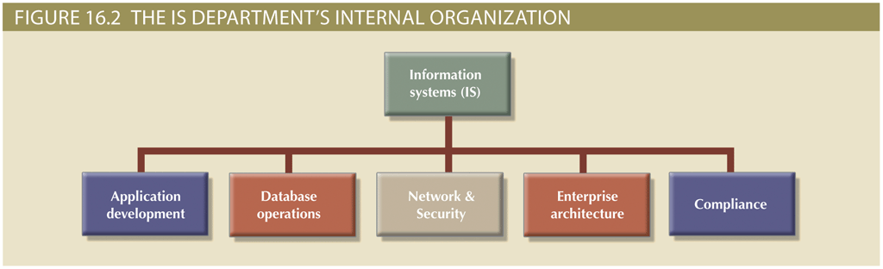
The Evolution of Database Administration (2 of 4)

Slide 11
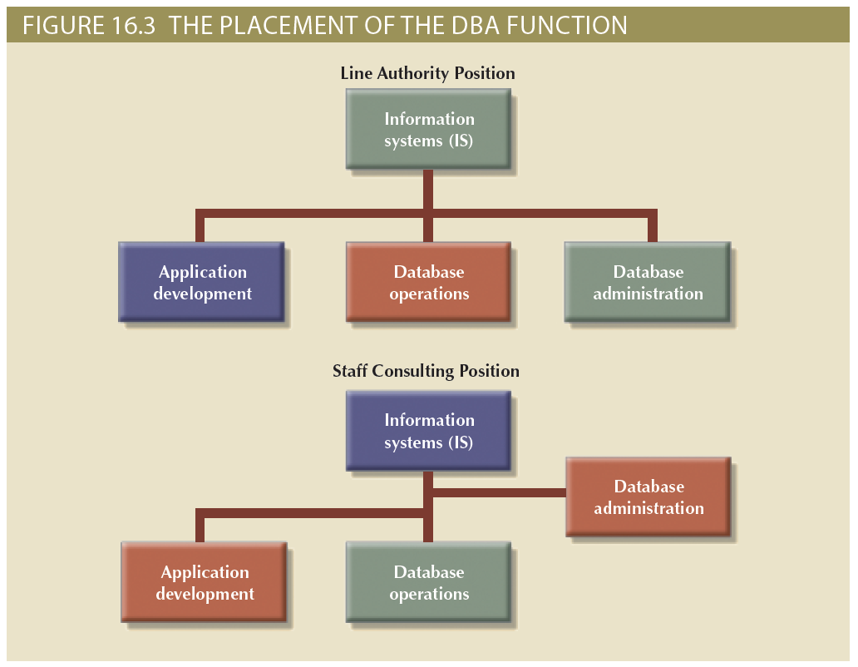
The Evolution of Database Administration (3 of 4)

Slide 12
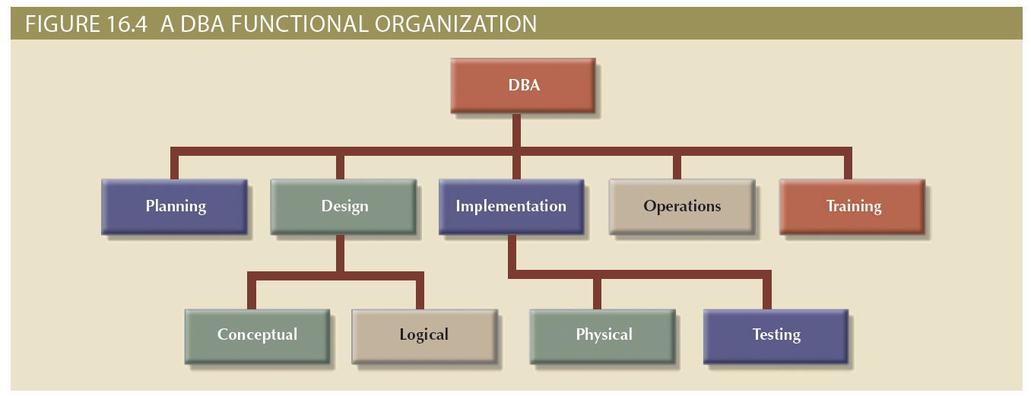
The Evolution of Database Administration (4 of 4)

Slide 13
The Database Environment’s Human Component (1 of 3)
Even the most carefully crafted database system cannot operate without human assistance
Effective data administration requires both technical and managerial skills
Administration goals are defined by various data issues
“Sharability” and time availability
Consistency and integrity
Security and privacy
Quality standards
Extent and type of use

Slide 14
The Database Environment’s Human Component (2 of 3)
Table 16.1: Contrasting DA and DBA Activities and Characteristics
Data Administrator (DA) | Database Administrator (DBA)
Performs strategic planning | Controls and supervises
Sets long-term goals | Executes plans to reach goals
Sets policies and standards | Enforces policies and procedures Enforces programming standards
Job is broad in scope | Job is narrow in scope
Focuses on the long term | Focuses on the short term (daily operations)
Has a managerial orientation | Has a technical orientation
Is DBMS-independent | Is DBMS-specific

Slide 15
The Database Environment’s Human Component (3 of 3)
Table 16.2: Desired DBA Skills
Managerial | Technical
Broad business understanding | Broad data-processing background and up-to-date knowledge of database technologies
Coordination skills | Understanding of Systems Development Life Cycle
Analytical skills | Structured methodologies • Data flow diagrams • Structure charts • Programming languages
Conflict resolution skills | Knowledge of Database Life Cycle
Communication skills (oral and written) | Database modeling and design skills • Conceptual • Logical • Physical
Negotiation skills | Operational skills: database implementation, data dictionary management, security, and so on
Experience: 10 years in a large DP department | Experience: 10 years in a large DP department

Slide 16
The DBA’s Managerial Role (1 of 2)
Important roles
Offer end-user support
Enforce policies, procedures, and standards for correct data creation, usage, and distribution within the database
Provide data security, privacy, and integrity
Supply data backup and recovery
Disaster management: planning, organizing, and testing of database contingency plans and recovery procedures
Ensure data is distributed to the right people, at the right time, and in the right format

Slide 17
The DBA’s Managerial Role (2 of 2)
Backup and recovery measures must include at least:
Periodic data and application backups
Proper backup identification
Convenient and safe backup storage
Physical protection of both hardware and software
Personal access control to the software of a database installation
Insurance coverage for the data in the database
Additional points
Data recovery and contingency plans must be tested, evaluated, and practiced frequently
A backup and recovery plan is not likely to cover all information system components

Slide 18
The DBA’s Technical Role
Areas of operation
Evaluate, select, and install DBMS and related utilities
Design and implement databases and applications
Test and evaluate databases and applications
Operate the DBMS, utilities, and applications
Train and support users
Maintain the DBMS, utilities, and applications

Slide 19
Security
Confidentiality
Protecting data against unauthorized access
Compliance
Activities that meet data privacy and security reporting guidelines
Integrity
Keeping data consistent and free of errors or anomalies
Availability
Accessibility of data whenever required by authorized users and for authorized purposes

Slide 20
Security Policies
Collection of standards, policies, and procedures created to guarantee security
Ensures auditing and compliance
Security audit process
Identifies security vulnerabilities
Finds measures to protect the system

Slide 21
Security Vulnerabilities
Weakness in a system component that could allow unauthorized access or cause service disruptions
Categories: technical, managerial, cultural, and procedural
Security threat: imminent security violation
Security breach: occurs when a security threat is exploited and could lead to a database whose integrity is preserved or corrupted
Preserved or corrupted

Slide 22
Database Security
DBMS features and related measures that comply with the security requirements
Authorization management: procedures to protect database security and integrity
User access management
View definition
DBMS access control
DBMS usage monitoring
Audit log: automatically records description of database operations performed by all users

Slide 23
Database Administration Tools
There are many sophisticated data administration tools
Monitoring
Load testing
Performance tuning
SQL code optimization
Bottleneck identification and remediation
Modeling and design
Data extraction, transformation, and loading

Slide 24
The Data Dictionary (1 of 2)
Main types
Integrated: included with the DBMS
Standalone: third-party systems
Active: automatically updated by the DBMS with every database access
Passive: requires running a batch process
Main function: store description of all objects that interact with the database
Provides database designers and end users with a much-improved ability to communicate
Helps the DBA resolve data conflicts

Slide 25
The Data Dictionary (2 of 2)
Key element of information resource management
Can be described as the information resource dictionary
Metadata is the basis for monitoring database use and for assigning access rights to users
Information stored in the data dictionary is usually based on a relational table format, thus enabling the DBA to query the database with SQL commands
DBA uses data dictionary to support data analysis and design

Slide 26
CASE Tools (1 of 2)
Computer-aided systems engineering (CASE) tools
Automated framework for the Systems Development Life Cycle (SDLC)
Use structured methodologies and powerful graphical interfaces
Classified according to extent of support provided
Front-end CASE tools: planning, analysis, and design phases
Back-end CASE tools: coding and implementation phases

Slide 27
CASE Tools (2 of 2)
Components of a CASE tools
Graphics
Screen painters and report generators
Integrated repository
Analysis segment
Program documentation generator

Slide 28
Developing a Data Administration Strategy
Information engineering (IE)
Translates strategic goals into data and applications
Information systems architecture (ISA)
Helps plan, develop, and control future information systems
Critical success factors
Management commitment
Thorough analysis of the company situation
End-user involvement
Defined standards
Training
A small pilot project

Slide 29
The DBA’s Role in the Cloud
Significant impact on role of DBAs
Tasks split between internal DBA and cloud service provider
Cloud service partner company provides:
DBMS installation and updates
Server/network management
Backup and recovery operations

Slide 30
The DBA at Work: Using Oracle for Database Administration
Tools and procedures
Supply Oracle database administration tools
Ensure the RDBMS starts automatically
Create tablespaces and datafiles
Tablespace: logical storage space
Datafile: physically stores the database’s data
Manage users and establish security
User: allows a given person to log on to the database
Role: authorizes a user to connect to the database and use its system resources
Profile: controls how much of the database resource a given user can access

Slide 31
Customizing the Database Initialization Parameters
Fine-tuning a database is an important task that usually requires modification of parameters
Initialization parameters reserve resources used by the database at run-time
Restart may be required after modifying parameters database
The DBA is responsible for a wide range of tasks
Quality and completeness of administration tools go a long way toward making the DBA’s job easier
The DBA must become familiar with the tools and technical details of the RDBMS to perform tasks properly and efficiently

Slide 32
Summary (1 of 3)
Data management is a critical activity for any organization, so data must be treated as a corporate asset
Data quality is a comprehensive approach to ensure the accuracy, validity, and timeliness of data
The DBMS is the most commonly used tool for corporate data management
The database administrator (DBA) is responsible for managing the corporate database
The DA and DBA functions tend to overlap

Slide 33
Summary (2 of 3)
A DBA’s managerial services include supporting end users; defining and enforcing policies, procedures, and standards for the database; ensuring data security, privacy, and integrity; providing data backup and recovery services; and monitoring distribution and use of the data in the database
The DBA’s technical role requires involvement in at least the following activities: evaluating, selecting, and installing the DBMS; designing and implementing databases and applications; testing and evaluating databases and applications; operating and maintaining the DBMS, utilities, and applications; and training and supporting users
Security refers to activities and measures that ensure the confidentiality, integrity, and availability of an information system and its main asset, data
A security vulnerability is a weakness in a system component that could be exploited to allow unauthorized access or service disruption

Slide 34
Summary (3 of 3)
The development of a data administration strategy is closely related to the company’s mission and objectives
To help translate strategic plans into operational plans, the DBA has access to an arsenal of database administration tools, including a data dictionary and computer-aided systems engineering (CASE) tools
With the introduction of reliable cloud-based data services, the role of the DBA has expanded beyond corporate walls

